Slide 1

AI-ML Virtual Internship
by
G.RAMYA SREE
Roll No. 214G1A3284
Department of Computer Science and Engineering (Data Science)
Srinivasa Ramanujan Institute of Technology
(Affiliated to JNTUA & Approved by AICTE) (Accredited by NAAC with ‘A’ Grade & Accredited by NBA (EEE, ECE & CSE)
Rotarypuram Village, B K Samudram Mandal, Ananthapuramu – 515701.
2023 - 2024

Slide 2

Contents
Course Objective
Introduction
Technology
Applications
Modules
Real Time applications
Learning outcomes
GitHub Link
Queries

Slide 3
Course Objective
Develop hands-on experience with AI and ML tools by implementing and evaluating algorithms on real-world datasets.
Enhance understanding of key AI/ML concepts through learning data preprocessing, model building, and advanced techniques such as neural networks and NLP.

Slide 4
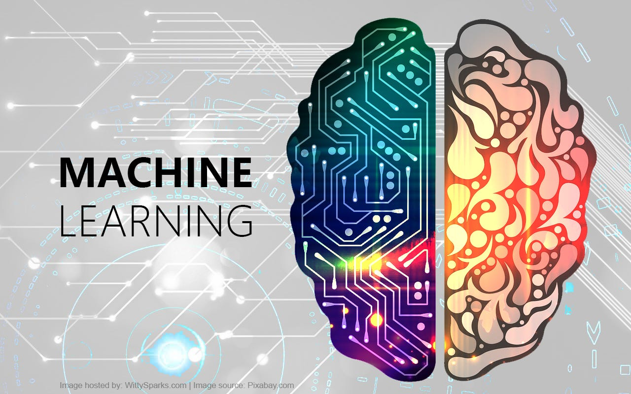
Introduction
Machine Learning(ML) :
Artificial intelligence (AI) and machine learning (ML) are related computer science fields that focus on creating software that can analyze, interpret, and understand data in complex ways
AI-ML empowers organizations to build sophisticated applications with increased flexibility,
scalability, and reliability.
AI/ML solutions are suited for complex tasks that
generally involve precise outcomes based on learned
knowledge.

Slide 5
Technologies
TensorFlow: An open-source machine learning framework used for building and training deep learning models. It offers flexibility and a comprehensive ecosystem of tools and libraries.
PyTorch: Another popular open-source machine learning library that provides dynamic computational graphs and is widely used for deep learning research and applications.
Keras: A high-level neural networks API, written in Python, and capable of running on top of TensorFlow, CNTK, or Theano. It's designed to enable fast experimentation with deep neural networks.
Spark MLlib: A scalable machine learning library in Apache Spark, offering various machine learning algorithms, utilities, and data processing tools.
OpenAI GPT: A family of AI models designed for natural language processing tasks, including text generation, translation, summarization, and more.

Slide 6
Applications
AI-ML offers a broad range of applications across various industries due to its scalable, reliable, and flexible services. Here are some key applications:
Google Cloud DataPrep: A data preparation tool for exploring, cleaning, and preparing structured and unstructured data.
Pre-trained Models and APIs:Microsoft Azure Cognitive Services: A collection of APIs for adding AI capabilities to applications, including vision, speech, language, and decision-making
Google Cloud Speech-to-Text: Converts audio to text by applying powerful neural network models.
Google AI Explainable AI: Tools for understanding and interpreting the predictions made by machine learning models.

Slide 7
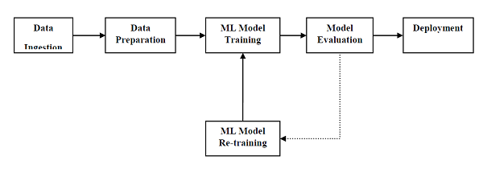
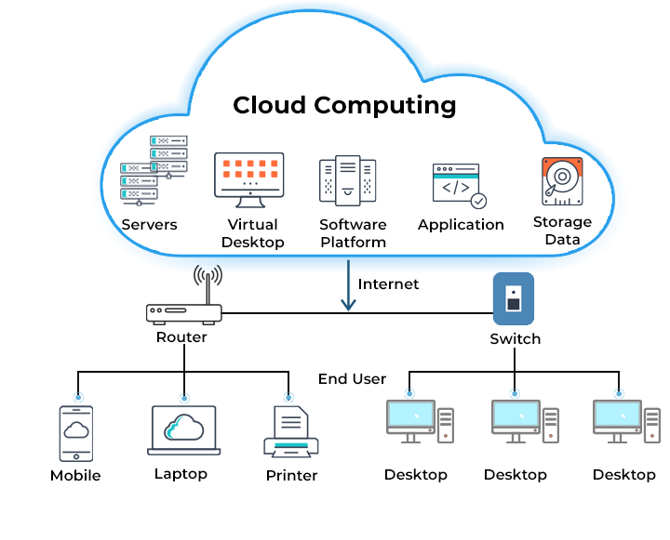
Modules
AI-ML Architecture :
AI-ML (Artificial Intelligence and Machine
Learning) architecture is the conceptual
structure that defines how AI and ML
systems are built, organized, and operate.
The architecture involves multiple layers
and components, each serving a specific purpose,
from data collection to model deployment.

Slide 8
Object detection: static image
Using machine learning, objects can be detected from a provided image
Static image object detection features uses existing Material Design components and new elements specific to interacting with an imageg efficiency, scalability, and flexibility in resource usage.
Static image detection using AI-ML involves using machine learning models to analyze and interpret images. The process generally involves several key steps, from data collection to model deployment.

Slide 9
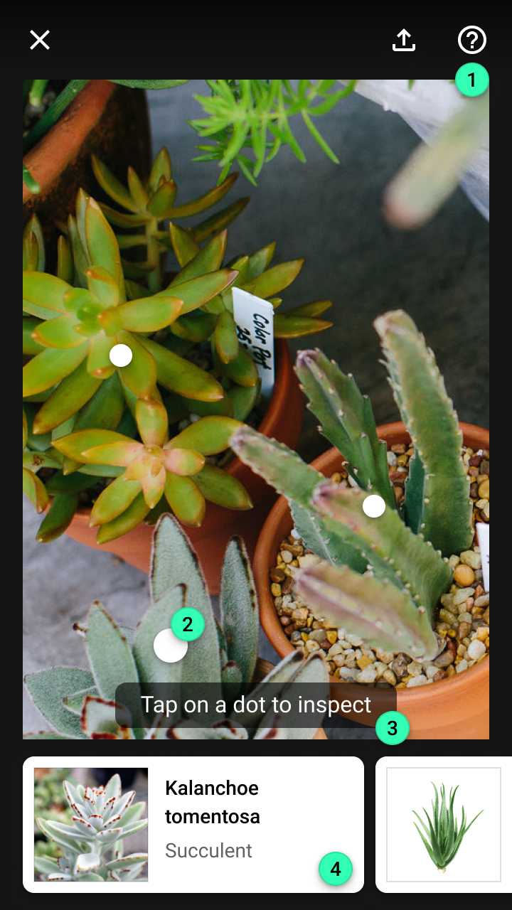
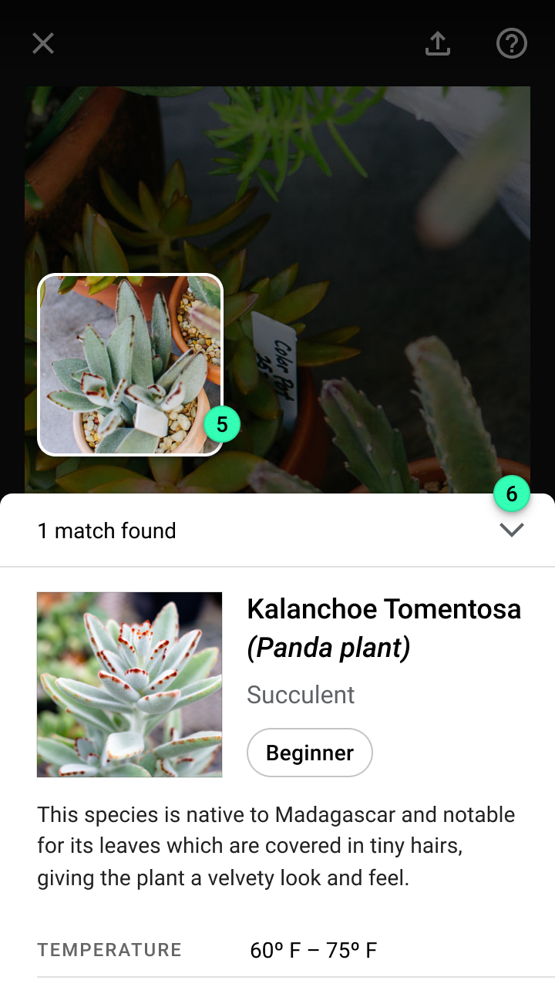
AI-ML Formation
Key elements across the stages of a
static image visual search experience: 1. Top app bar 2. Object marker 3. Tooltip 4. Cards 5. Detected image 6. Modal bottom sheet

Slide 10
Cont..
1.Top App Bar:
Description: The top app bar, also known as the toolbar, is a horizontal bar at the top of the screen that usually contains the app’s title, navigation elements, and actions such as search or settings.
Usage: It's used to provide quick access to key functionalities like navigation drawers or to display the title of the current screen.
2.Object Marker:
Description: An object marker is an icon or visual indicator that highlights or marks specific objects or elements in a UI.
Usage: Often used in lists or grids to signify status, priority, or some other attribute of an item.

Slide 11
Cont…
3.Tooltip:
Description: A tooltip is a small, informative text box that appears when a user hovers over or focuses on an element, providing additional information about the element.
Usage: It helps to provide users with contextual information or guidance without cluttering the
4.UI.Cards:
Description: Cards are UI containers that group related content and actions about a single subject. They often include images, text, and links.
Usage: Cards are commonly used to display information in a concise, digestible format, such as in a news feed or product listings.

Slide 12
Cont…
5.Detected Image:
Description: This typically refers to an image that has been analyzed or identified by an AI model (e.g., object detection, face recognition).
Usage: In UI, it could be used to display the results of an image processing task, such as highlighting detected objects within an image.
6.Modal Bottom Sheet:
Description: A modal bottom sheet is a UI element that slides up from the bottom of the screen, usually covering part of the screen. It presents users with additional options or information.
Usage: It is used for supplementary content that doesn’t require a full screen, such as actions related to a specific item or additional details.

Slide 13
Real Time Applications
Healthcare
Finance
Transportation
Telecommunications
Gaming
Manufacturing
Smart Cities
E-commerce
Logistics and Supply Chain
Energy

Slide 14
Learning Outcomes
Understanding of AI-ML Architecture & its benefits.
Easily understandable about the AI-ML .
It’s applications in real time.

Slide 15
GitHub Link

Slide 16
Any Queries?

Slide 17
Thank You!!!

